Slide 1
Summary of lecture on 17 March, Linear transformation
Linear Transformation and matrix
Every linear Transformation T maps n-dim
vectors to m-dim vectors
can be represented by a Matrix A
Furthermore
Tu=Au=multiplication of matrices A and u

Slide 2
Example
Linear transformation
T : 2-D vectors
2-D vectors
If
Then

Slide 3
Example
Linear transformation
T : 3-D vectors
2-D vectors
If
Then

Slide 4
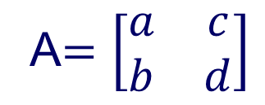
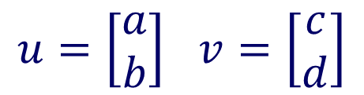
Volume and Determinant
Let
$$u=\left[\begin{matrix}a \\ b\end{matrix}\right] v=\left[\begin{matrix}c \\ d\end{matrix}\right]$$
Let
A$=\left[\begin{matrix}a & c \\ b & d\end{matrix}\right]$
which is the matrix
induced by vectors
u and v
Area of parallelogram induced by u and v
=

Slide 5
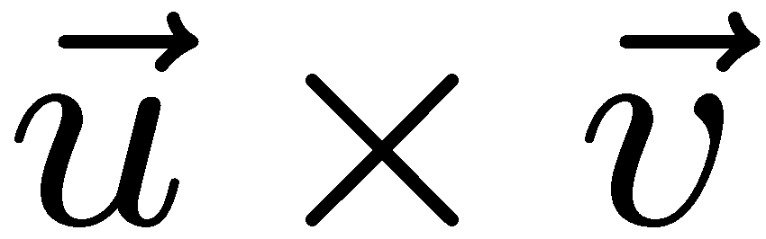
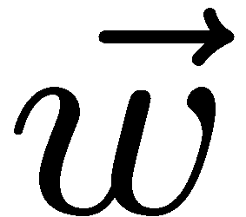
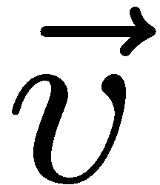

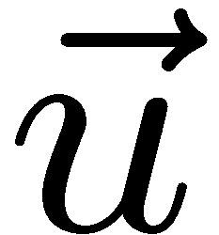
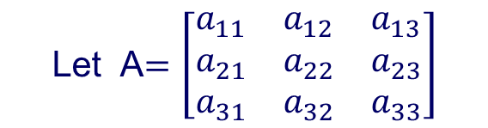
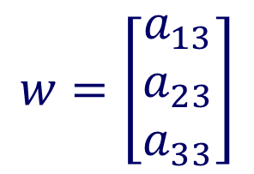
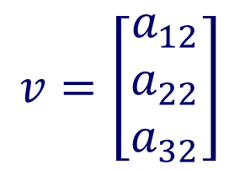
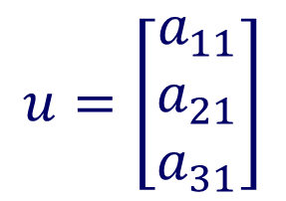
$$u=\left[\begin{matrix}a_{11} \\ a_{21} \\ a_{31}\end{matrix}\right]$$
$$v=\left[\begin{matrix}a_{12} \\ a_{22} \\ a_{32}\end{matrix}\right]$$
$$w=\left[\begin{matrix}a_{13} \\ a_{23} \\ a_{33}\end{matrix}\right]$$
Let A$=\left[\begin{matrix}a_{11} & a_{12} & a_{13} \\ a_{21} & a_{22} & a_{23} \\ a_{31} & a_{32} & a_{33}\end{matrix}\right]$
Vol of parallelepiped induced by u,v and w
=

Slide 6
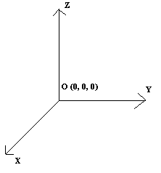
Image of T from 3D to 3D
A transformation T from 3-D to 3-D has ONLY three cases:
Case1: det(T) not zero
T maps the whole 3-d space ONTO the whole 3-d space

Slide 7
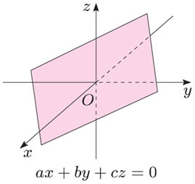
Case 2: det(T)=0
Subcase 1
T maps the whole 3-d space
ONTO a plane (the whole plane)
passing through origin

Slide 8
Subcase 2
T maps the whole 3-d space
ONTO a line (the whole line)
passing through origin

Slide 9
AX=B and linear mapping
Consider linear system of three equations
or more precisely
Now we may consider: matrix A maps a point
to a point

Slide 10
Suppose
Then we know that for any
We can find
such that
Hence matrix A maps the whole 3D space ONTO
the whole 3D space

Slide 11
Suppose
Then the matrix A maps the whole 3D space
onto a plane or onto a line
A(whole 3D space) is call
the image of 3D space under mapping A
Given a point
If this point is not in the image
Then we can’t find
such that
It means this system of equations has no solution for this case

Slide 12
Suppose
Then
Suppose
The image of the whole 3D space depends
on the relation between

Slide 13
If
then the image is a line passing through origin
i.e., A maps the whole 3D space onto a line
Example
A maps the whole 3D space
onto a line passing through (0,0,0) and (1,1,0)

Slide 14
If
then the image is a plane passing through origin
i.e., A maps the whole 3D space onto a plane
Example
i.e., A maps the whole 3D space onto a plane
induced by

